Slide 1

Welcome to SOFT166 Programme Intro & Dev
Dr Shirley Atkinson
Web Dev part….
Notes:
Welcome to the session on introducing API’s.

Slide 2
Outline of session
APIs
JQuery checkup
Arrays
Loops
Saving Data
Notes:
Slides at very end are for reference

Slide 3

What is an API?
Request
Response
“Application Programming Interface”
Software to Software communication
A method to deliver data or service
A developers contract
API
Notes:
What is an API?
The term is an acronym for Application Programming Interface.
We are looking at something that has no pretty bits for human beings to marvel over, it is a way of one piece of software communicating with another piece of software, it is machine to machine communication, or even on the same machine.
An API is a hook for accessing data or a service and is part of our very connected world. Before the dominance of the web and the Internet, an API would allow you access into other software – for example the Win32API allowed you access to functions and/or data structures provided by the operating system. Now we are in the web world and these API’s take on a different life.
An API provides a contract to a developer that data or web services will be delivered, and as such a developer will rely on that API.
At a base level all API’s will do the same thing. They receive a request, process it in some way and return a response.

Slide 4
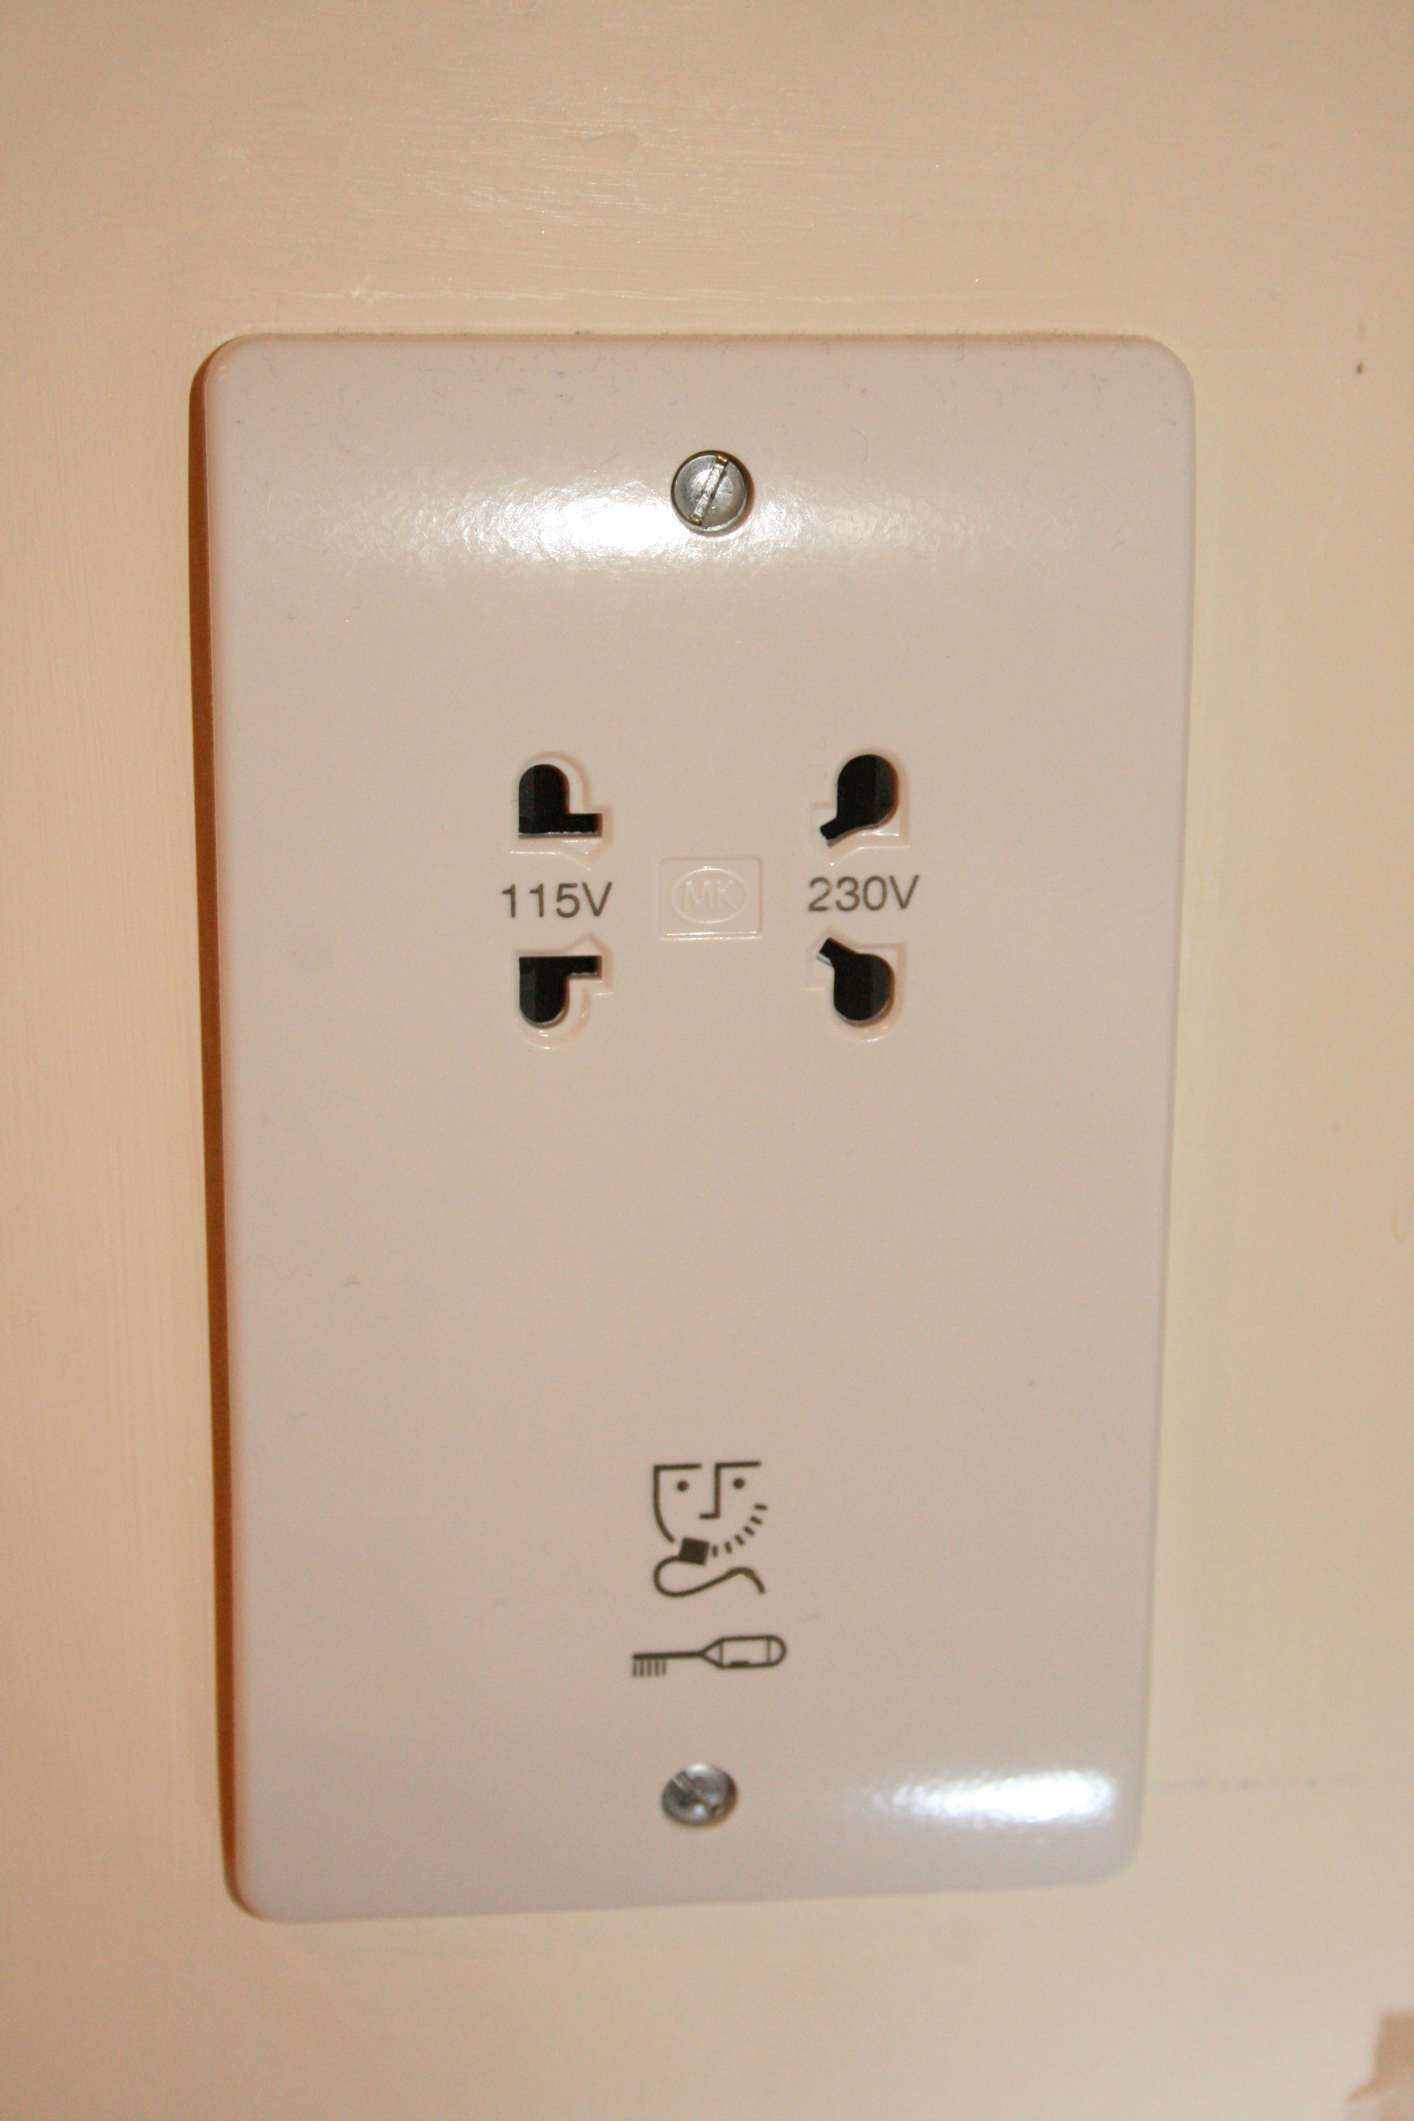
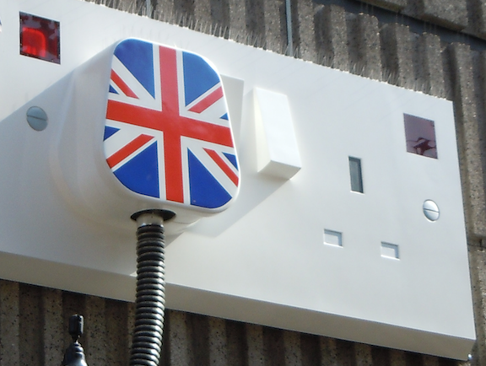
Notes:
Generally you know what to expect with a plug. You know what to plug into it. You know looking at it that you don’t put the same type of plug into the left hand socket as you do in the right hand socket.
This is a standard interface. Any compatible plug can access the power – and the device that has the plug knows what to do with the power. Those who make devices can do so safe in the knowledge of what they are getting – they are getting something conforming to the standard. They don’t have to worry about how they will get to the power, they just know it will get delivered.
The socket is a layer of abstraction. The device maker does not need to know about the colour of the wires, or whether the electricity is from a renewable source or not, where the power has come from, The abstractions go both ways. The socket maker does not need to know about the device being plugged into it, the electricity provider does not need to know about the devices consuming the electricity.
And so it is the same with data or messages. That is what an API delivers, data that can be consumed by the application that calls it. So the app itself does not need to worry about how to store the data, how to ensure it’s integrity – it outsources those requirements. As an app developer you can pull in functionality from these API’s without having to create it yourself.
CC2 (https://creativecommons.org/licenses/by/2.0/) British Power image courtesy of https://www.flickr.com/photos/kevandotorg/
Shaver socket - By Wiz9999 - Own work, CC0, https://commons.wikimedia.org/w/index.php?curid=69707354

Slide 5

Why?
Interconnectivity We live in a world where many will expect instant connectivity via the devices they carry around with them. We have become used to looking up information on the move – when is my next train, can I buy my ticket, what is the weather going to be like there, what is the cheapest flight and indeed can I pay by credit card or third party provider such as PayPal.
Data Data sharing between devices has become expected. Consumers expect to have the same seamless interaction irrespective of whether they are using their laptop or their smartphone. However, data needs to be in one place, it needs to be shared consistently and robustly.
Developers Infrastructure Irrespective of the language you create your application in, you can access other features and data sets that would be beyond your reach to create yourself.
Notes:
We live in a world of interconnectivity. Consider the devices you use today. Did you look up your train time? Perhaps you looked up the traffic to see about how to get to where you wanted to go. May be you were shopping online, comparing prices, or looking for a holiday and comparing flights. Each of those companies hold their data in their databases – you do not have direct access to their databases, but via an app, via an aggregator you may be granted special privileged access to their data – because they have allowed it.
Many have become used to that connectivity. They are using the many devices they have and they want to not to have to re-enter their data, or they want the interaction to be seamless. However, for that to work effectively the data must be held in one place, accessible by the many different clients and to have no dependencies between the different pieces of software or platforms. Imagine if you had to have one place to store data that worked android applications and one place to store data for apple devices. There has to be a uniformity in sharing data, the applications need to be able to deal with that data without too much overhead.
Finally this links into the developers infrastructure. This is about having developers as partners in business without having to hire them, but where software, applications are created that bring business via the API in such a way where everybody benefits.

Slide 6
Usage
Mobile ownership Smartphone ownership increasing – globally. Pew Internet report the gap between emerging and established economies is shrinking
Internet 40% of the world has an internet connection in 2018
Websites Increasingly features in websites are provided by third parties – not the web developer themselves. Google maps API is a good example.
UK Households with mobile phones*
Internet users 2018
Website traffic via mobile
95%
52.2%
over 3 billion
Notes:
So the reason why this is pertinent to today is very much around our ownership of these devices. Looking at the figures the majority of UK households – 95% - are spending money on mobile phones. It is rare for somebody NOT to have a mobile now. When we look globally we see that the gap between the established economies and the emerging economies is shrinking.
Add to the mobile device ownership statistics, we also see how much is now delivered via the internet. 52.2% of website traffic is now delivered to a mobile device. There are over 3 billion internet users now. 40% of the world has an internet connection.
Think about the websites you have made use of. What interactivity did they have with them? Increasingly the features you see in the websites are provided by third parties – not the web developers themselves. Look at how a number of websites will embed a map – where does that map come from? Google. Google Maps API is a good example.
Pew Internet report - http://www.pewglobal.org/2016/02/22/smartphone-ownership-and-internet-usage-continues-to-climb-in-emerging-economies/. Smartphone ownership and internet usage continues to climb in emerging economies. 2016.
* Household Spending figures from ONS for financial year ending 2015 to financial year ending 2017. https://www.ons.gov.uk/peoplepopulationandcommunity/personalandhouseholdfinances/expenditure/datasets/percentageofhouseholdswithdurablegoodsbycountriesandregionsuktablea48
Website traffic Figures from statista https://www.statista.com/statistics/241462/global-mobile-phone-website-traffic-share/
Internet users Figures from http://www.internetlivestats.com/internet-users/

Slide 7
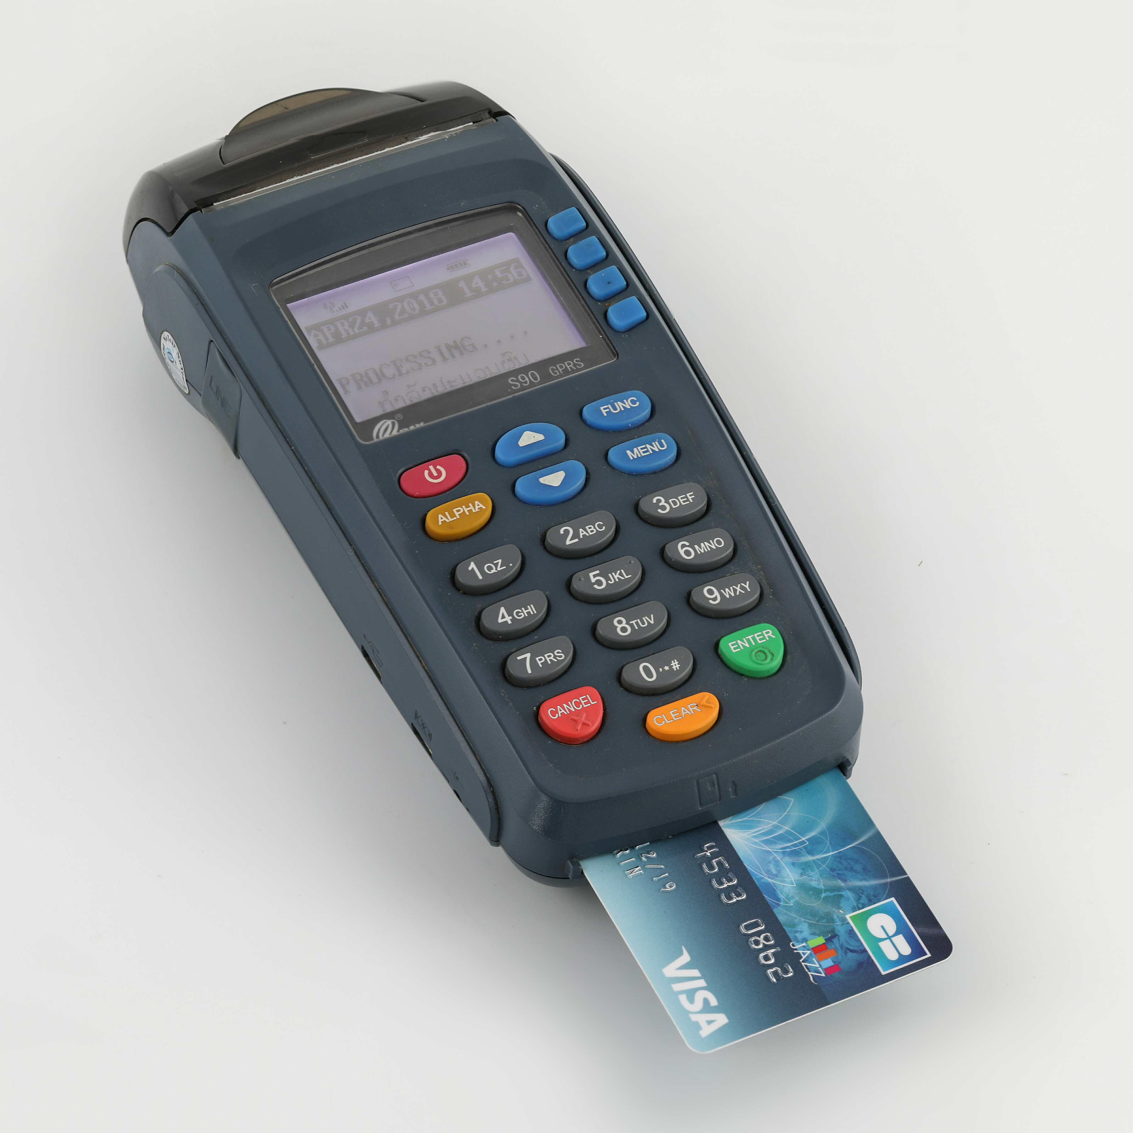
Benefits : Consuming API’s
Developers create software quickly using established APIs
Established APIs are usually often-repeated, complex pieces of functionality – and developers use them with a few lines of code
credit card payments
Notes:
So lets look at the benefits of APIs. First lets look at the benefits around using them and from this perspective we consider the developers community as they are the ones making use of these APIs.
Developers can quickly make use of third party API’s to create apps that are quite feature rich. App developers can use API’s offered by the system they are working on – for example using the APIs provided by the device provider they can access the GPS data, the location of the phone.
The well established API’s wrap up and abstract often-repeated, complex pieces of functionality and then make that available to the developer with just a few lines of code. This makes the developer much more productive than having to write everything from scratch. Credit cards are a good example. There are a number of issues around dealing with the processing of those payments – this chart shows you the interactions that have to take place. Then there are the security issues – storage of personal details is not something to be undertaken lightly. There are plenty of rules around how personal data must be handled – GDPR for example in the UK. What about trust issues – would you buy from somewhere that might take your credit card details and then allow them to be used in a fraudulent fashion?
So it is much easier in that regard to use a few lines from a third party API that deals specifically with processing payments – Paypal or Stripe.
By Basile Morin - Own work, CC BY-SA 4.0, https://commons.wikimedia.org/w/index.php?curid=68543817
By Nitishwiki33 [CC BY-SA 4.0 (https://creativecommons.org/licenses/by-sa/4.0)], from Wikimedia Commons

Slide 8

API Economy
Access to digital assets/services in controlled fashion that directly improves productivity
Web browser APIs provide access to
Camera
Hosts File structure
Audio
Active apps and websites use Google Maps API
Growth for Google Maps
2 million
300%
Notes:
In recent years we see the “API Economy” emerge. The exposure of the digital services and/or assets of an organization. This allows a controlled access that has a positive effect on an organizations profit margin. As the Internet of Things becomes the norm, accessing devices via smartphones becomes desireable, so to does the provision of an API to manipulate the “things”.
And it is not just “things” – there is the every day use of the web too. Modern web browsers now provide access via APIs. You can access the camera, the host file structure and audio for example.
API’s have been referred to as the “engine of innovation” (Programmable web). Think about Uber – the use of Google maps helped drive the application. Google Maps API spawned more innovation than just Uber, according to Apigee in their 2017 report on the state of API’s over 2 million active apps and websites use the Google Maps API every week, which contributed to Google Maps growth of 300% over the last two years. Then there is Instagram – built on the Facebook API allowing the users to broadcast latest photos on Facebook.
APIGee - https://apigee.com/api-management/#/resources
By Joka2000 Camera https://www.flickr.com/photos/joka2000/ Creative Commons 2:0

Slide 9
Benefits : Providing APIs
Internally – information wrapped up and delivered easier
Externally – open up new markets, attract new innovation by enabling core business services to be “mashed-up” by people from outside.
Notes:
The other side of the API coin is that people need to provide them.
https://apigee.com/about/blog/technology/why-and-how-apis-open-api-model

Slide 10

Working Definition
An API is a way of two software applications talking to each other over using a common language that they both understand
This may be over a network (the internet)
API's follow a specification
Notes:
And so to our working definition that we shall use throughout this course.
An API is a mechanism that provides a way for two software applications to talk to each other using a common language that they both understand.
This could be done over a network – usually the internet. However, they could be on the same device or machine – but in our case they still need to be delivered over TCP/IP – internet protocols.
API’s have to follow a specification. That specification means the API provider describes exactly what the functionality is that the API is offering, they describe any technical constraints within the API, such as rate limits that might control how many times an application can make a request. The API provider might also outline in the specification any legal or business constraints for using the API – branding limitations, conditions of use and others. Developers have to agree to use the API as described and they agree to the rules set out by the API provider.

Slide 11
Hue Lights
Other settings:
Saturation is the intensity of the colour. 254 is most coloured and 0 is least (eg: white)
“sat” : 254
Brightness : how bright it is!
“bri” : 254
Hue : a measure of colour. Range is 0 to 65535
“hue” : 10000
Already seen concept of URI
AJAX code creates HTTP packet to send
GET goes and gets information
PUT used to set a value
So far only turned it on and off
Notes:
https://developers.meethue.com/develop/get-started-2/
Core concepts only viewable with a developer account

Slide 12
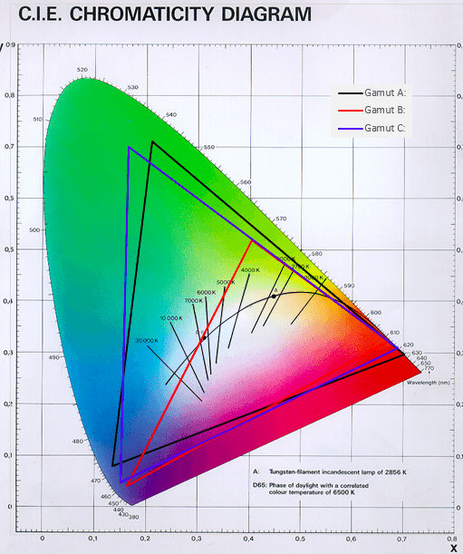
Hue Colours : “hue” : n
0 and 65535 are both Red
25500 is Green
46920 is Blue
12750 is Yellow
56100 is Pink
More to it than simple colours

Slide 13
JQuery
Menti.com questions….

Slide 14
Review of arrays
Collection of values arranged under a single name
Has an index – a number which distinguishes an individual value within the collection
LightsState[“2”]
References an array called lightsState with an ID of 2
Indexes start at 0
Declared
Var lightsState = new Array(6)
Length does not have to be given – if not given then array will expand automatically as more things added

Slide 15
Arrays…
LightsState[2] = on;
Add to your array
Initialise with all values at start
Work out how many values in there
var LightsState = new Array(on, off, on, off, on, off);
LightsState.length

Slide 16
Review “for” loops
A counter variable to track the number of times a sequence of commands is run
Stops when counter variable reaches or exceeds specified value
for (start; continue; update)
{
stuff to do
}

Slide 17
Review “while” loops
Command block runs so long as a condition is met
Condition in while loop does not rely on value of counter variable
Continue has to be a boolean
while (continue)
{
stuff to do
}

Slide 18
Local Storage
Working client side so cannot save files
Local storage allows data to be stored in browser
New in HTML5
Prior had to save cookies
Web storage is more secure and storage limit is larger
All pages from same origin can store and access same data
Notes:
https://www.w3schools.com/html/html5_webstorage.asp

Slide 19
Local storage
Helps prevent unnecessary requests back to server
Lowers traffic
Good for mobile apps as maintains functionality if have unreliable connection
Save user preferences
Save session state

Slide 20
Web Storage
Local storage
Data has no expiry date and will stay after the browser window is closed
Session storage
Data that gets cleared after the browser window is closed

Slide 21
Local storage methods
setItem – add a key value pair into local storage
getItem – retrieve a value using the key
removeItem – remove an item by a key
Clear – get rid of the lot

Slide 22
This week..
Practice a little more Javascript and JQuery
Use local storage

Slide 23
Coursework workshop
The rest of the time is dedicated to your questions regarding the coursework and to provide feedback where required

Slide 24

University of Plymouth
Advancing knowledge, transforming lives

